Slide 1

DIGITAL LOGIC DESIGN (111776)
Dr. Owais Hussain

Slide 2

Agenda
State Diagram
State Table
State Table of JK Flip Flop
State Table and Diagram of T Flip Flop
State Table and Diagram of Multiple Flip Flops

Slide 3
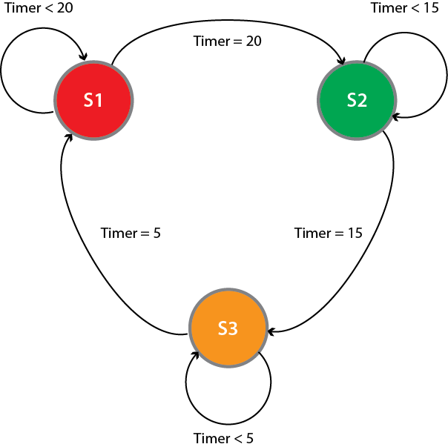
Sample 2
State Diagram
State diagram, also known as state graph, is pictorial representation to understand how a system behaves over time.
It is used to show the connections between the current state, the input state, the next state, and the output state of a sequential circuit in digital electronics.
The given example shows how a traffic light changes its states given that the signal should be RED for 20s; GREEN for 15s; YELLOW for 5s

Slide 4
Sample 2
State Table
State Table is the tabular representation of a state diagram.
It differs from Truth Table in sense that it contains both previous state and next state along with the inputs.
The given State Table represents the Traffic light, which inputs a clock that resets every 40 seconds.
Previous | Input | Next
RED | 0 to 19 | RED
RED | 20 | GREEN
GREEN | 20 to 34 | GREEN
GREEN | 35 | YELLOW
YELLOW | 35 to 39 | YELLOW
YELLOW | 40 | RED

Slide 5
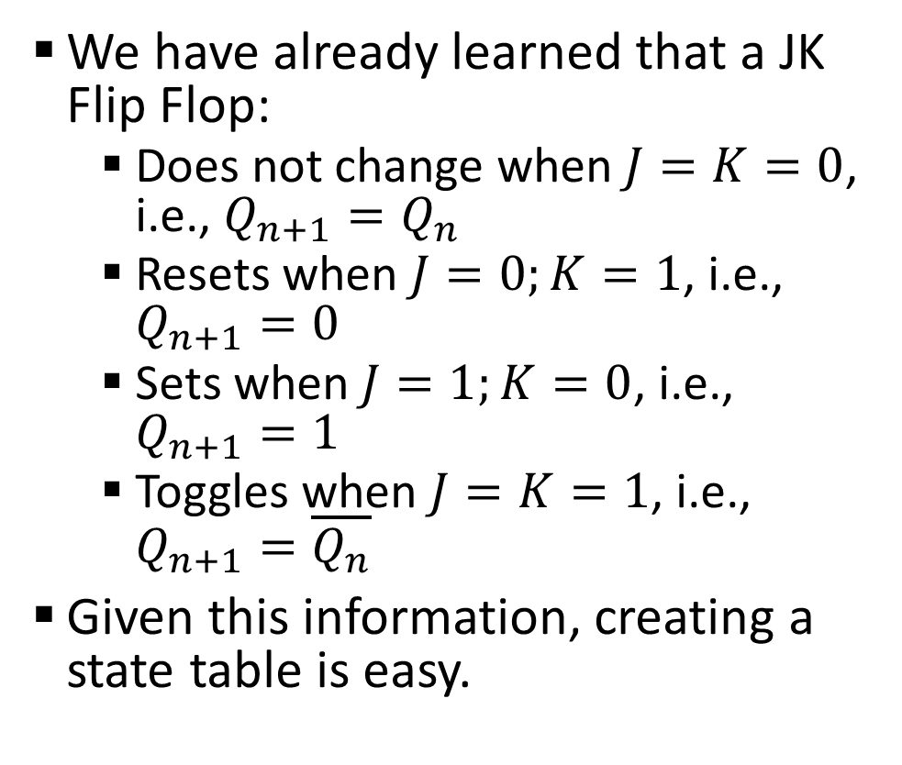
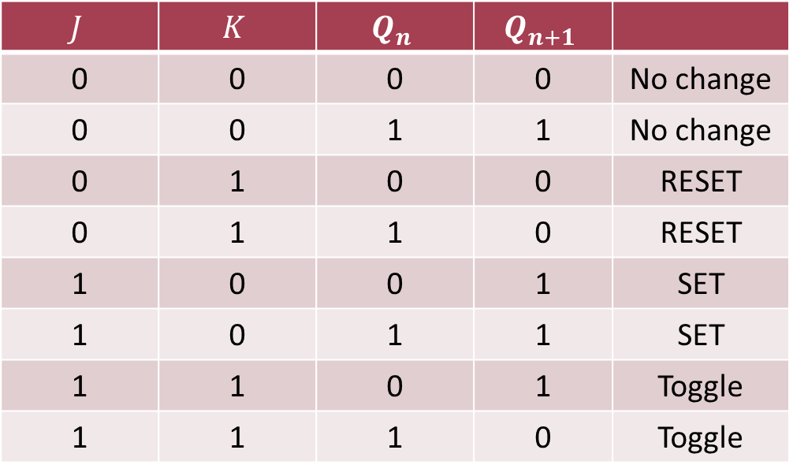
Sample 2
State Table of JK Flip Flop
We have already learned that a JK Flip Flop:
Does not change when $J=K=0$, i.e., $Q_{n+1}=Q_{n}$
Resets when $J=0;K=1$, i.e., $Q_{n+1}=0$
Sets when $J=1;K=0$, i.e., $Q_{n+1}=1$
Toggles when $J=K=1$, i.e., $Q_{n+1}=\overline{Q_{n}}$
Given this information, creating a state table is easy.
$$J$$ | $$K$$ | $$Q_{n}$$ | $$Q_{n+1}$$
0 | 0 | 0 | 0 | No change
0 | 0 | 1 | 1 | No change
0 | 1 | 0 | 0 | RESET
0 | 1 | 1 | 0 | RESET
1 | 0 | 0 | 1 | SET
1 | 0 | 1 | 1 | SET
1 | 1 | 0 | 1 | Toggle
1 | 1 | 1 | 0 | Toggle

Slide 6
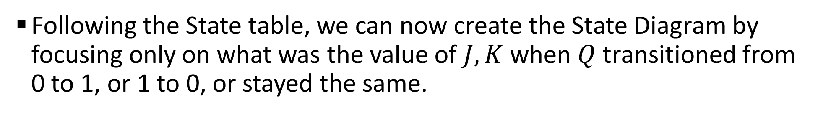

Sample 2
State Diagram of JK Flip Flop
Following the State table, we can now create the State Diagram by focusing only on what was the value of $J,K$ when $Q$ transitioned from 0 to 1, or 1 to 0, or stayed the same.
$$J$$ | $$K$$ | $$Q_{n}$$ | $$Q_{n+1}$$
0 | 0 | 0 | 0 | No change
0 | 0 | 1 | 1 | No change
0 | 1 | 0 | 0 | RESET
0 | 1 | 1 | 0 | RESET
1 | 0 | 0 | 1 | SET
1 | 0 | 1 | 1 | SET
1 | 1 | 0 | 1 | Toggle
1 | 1 | 1 | 0 | Toggle
J=1
Q=0
Q=1
J=0
K=0
K=1

Slide 7
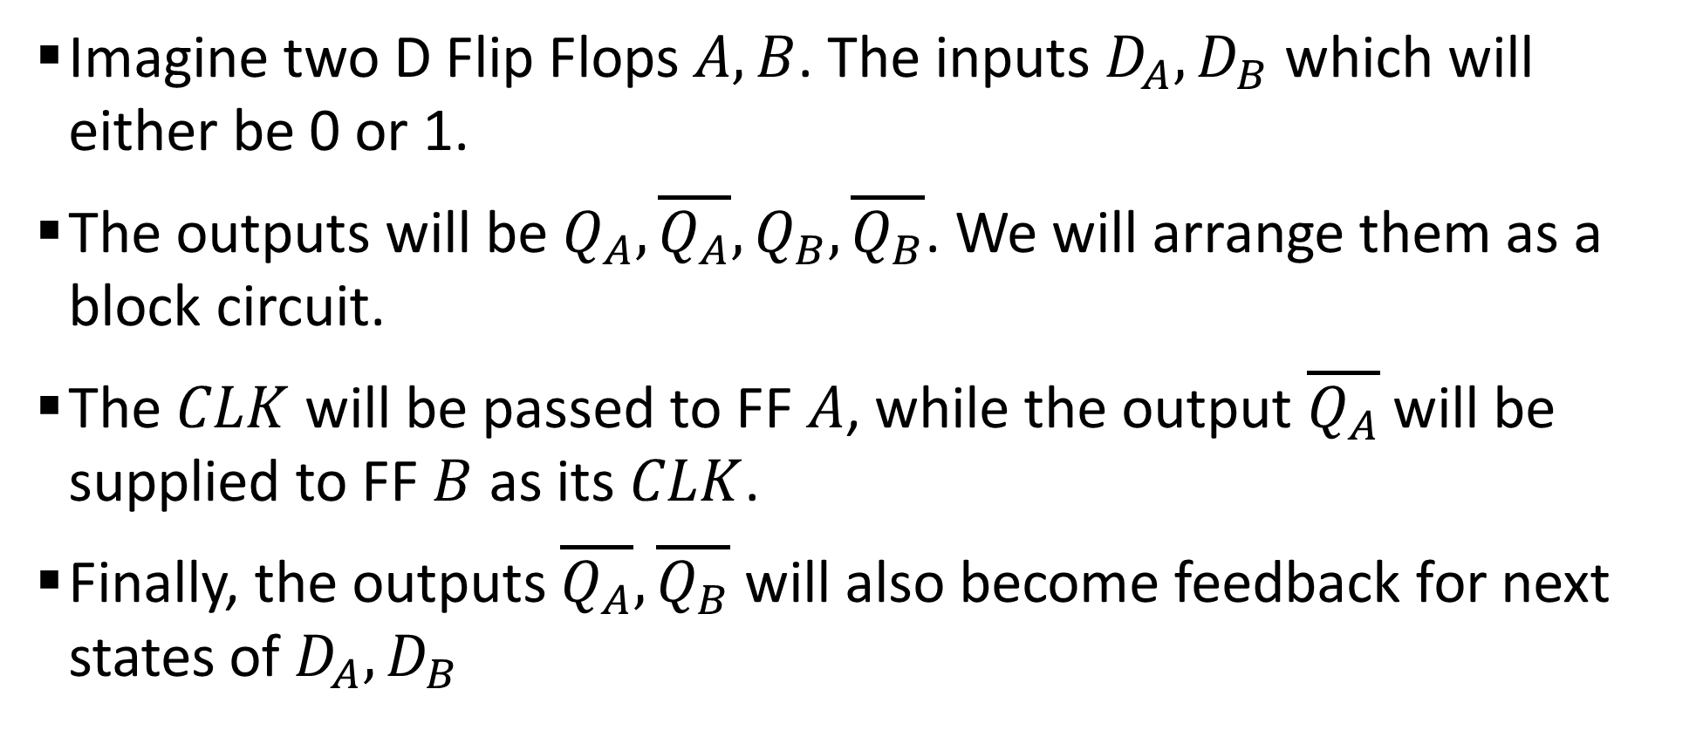
Sample 2
State Table and Diagram of Multiple Flip Flops
Imagine two D Flip Flops $A,B$. The inputs $D_{A},D_{B}$ which will either be 0 or 1.
The outputs will be $Q_{A},\overline{Q_{A}},Q_{B},\overline{Q_{B}}$. We will arrange them as a block circuit.
The $CLK$ will be passed to FF $A$, while the output $\overline{Q_{A}}$ will be supplied to FF $B$ as its $CLK$.
Finally, the outputs $\overline{Q_{A}}, \overline{Q_{B}}$ will also become feedback for next states of $D_{A},D_{B}$

Slide 8
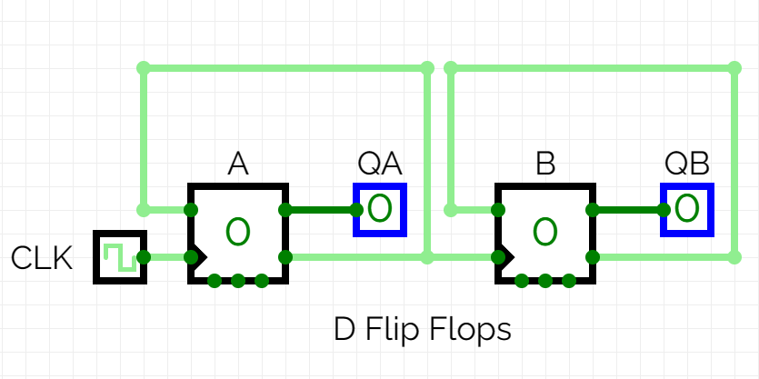
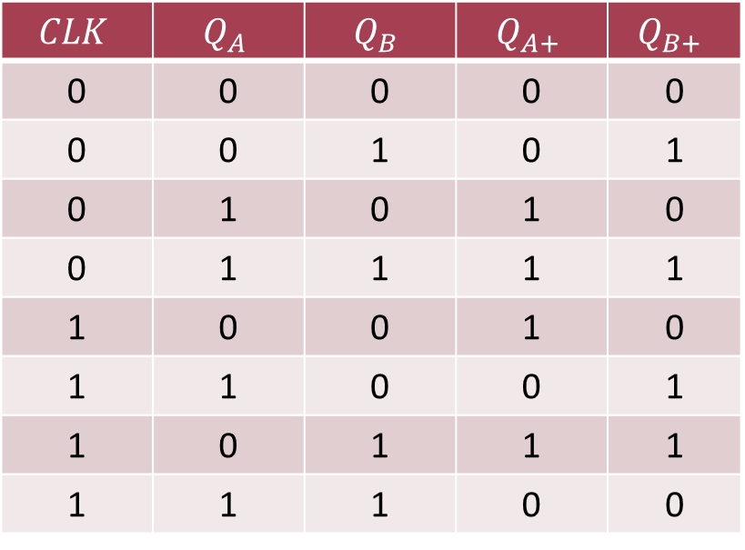
Sample 2
State Table and Diagram of Multiple Flip Flops
$$CLK$$ | $$Q_{A}$$ | $$Q_{B}$$ | $$Q_{A+}$$ | $$Q_{B+}$$
0 | 0 | 0 | 0 | 0
0 | 0 | 1 | 0 | 1
0 | 1 | 0 | 1 | 0
0 | 1 | 1 | 1 | 1
1 | 0 | 0 | 1 | 0
1 | 1 | 0 | 0 | 1
1 | 0 | 1 | 1 | 1
1 | 1 | 1 | 0 | 0
Notes:
Recall that a D Flip Flop latches only when CLK is 1. Therefore, $A$ will produce 1 on next stage only when $Q_{A}=0$

Slide 9
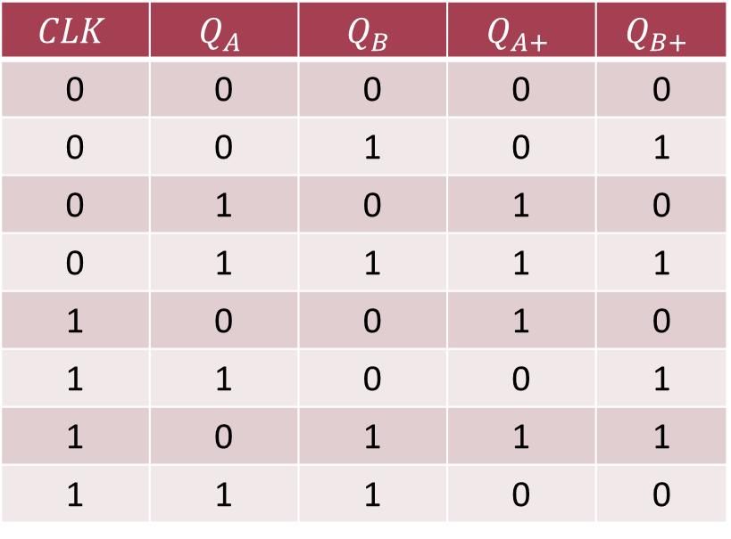
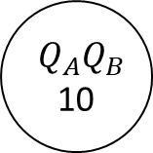
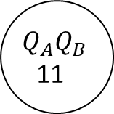
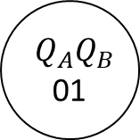
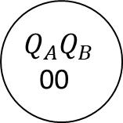
Sample 2
State Table and Diagram of Multiple Flip Flops
$$CLK$$ | $$Q_{A}$$ | $$Q_{B}$$ | $$Q_{A+}$$ | $$Q_{B+}$$
0 | 0 | 0 | 0 | 0
0 | 0 | 1 | 0 | 1
0 | 1 | 0 | 1 | 0
0 | 1 | 1 | 1 | 1
1 | 0 | 0 | 1 | 0
1 | 1 | 0 | 0 | 1
1 | 0 | 1 | 1 | 1
1 | 1 | 1 | 0 | 0
$$Q_{A}Q_{B}$$
00
$$Q_{A}Q_{B}$$
01
CLK=0
CLK=0
CLK=1
CLK=1
CLK=1
CLK=1
$$Q_{A}Q_{B}$$
11
$$Q_{A}Q_{B}$$
10
CLK=0
CLK=0
Notes:
Recall that a D Flip Flop latches only when CLK is 1. Therefore, $A$ will produce 1 on next stage only when $Q_{A}=0$

Slide 10
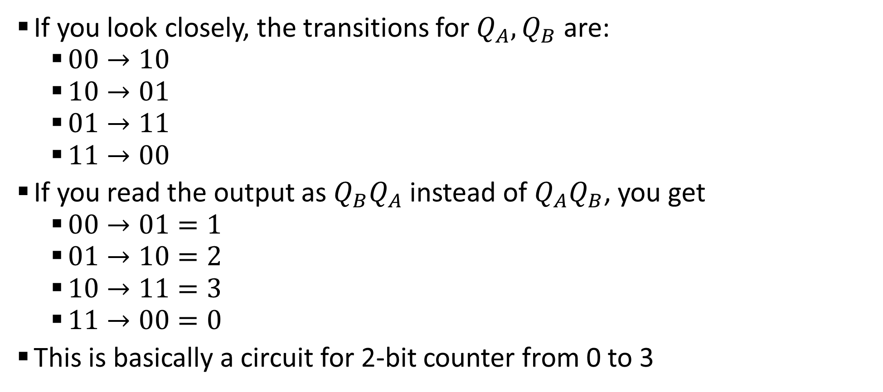
Sample 2
State Table and Diagram of Multiple Flip Flops
If you look closely, the transitions for $Q_{A},Q_{B}$ are:
$00→10$
$10→01$
$01→11$
$11→00$
If you read the output as $Q_{B}Q_{A}$ instead of $Q_{A}Q_{B}$, you get
$00→01=1$
$01→10=2$
$10→11=3$
$11→00=0$
This is basically a circuit for 2-bit counter from 0 to 3

Slide 11



THANK YOU
Owais Hussain
+92 345-3174270
owais.hussain@kiet.edu.pk
https://www.researchgate.net/profile/Owais-Hussain-3

